Slide 1

Capstone Project
Bike Sharing Demand Prediction
Supervised ML Regression Model
BY:- Ajit Padole

Slide 2
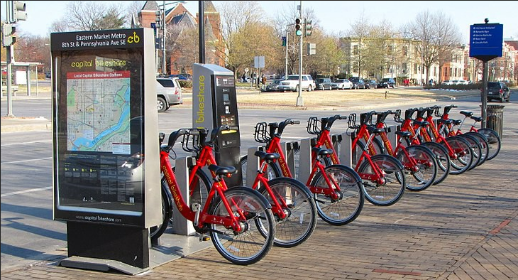
Concept of Bike Sharing

The basic concept of bike sharing is sustainable transportation. Bike sharing programs have expanded rapidly in recent years as cities search for ways to increase bike usage, increase mobility choices and reduce adverse environmental impacts.
It is a convenient, environmentally friendly way to get around town, but has flaws too. Certain conditions must be met for the proper implementation of this program. Bike sharing Demand is affected by multiple factors including temperature, resources, and many more.

Slide 3
Working Segregation of Bike Sharing Demand
Problem Statement
Data Summary
EDA & Feature Engineering
Feature Selection
Preparing Dataset
For Modelling
Conclusion
Model Validation & Selection
Challenges
Implementing Regression Models

Slide 4
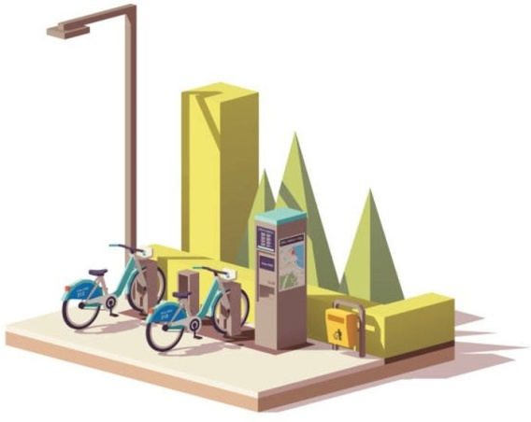
Problem statements

Prediction of bike count required at each hour.
What factors affect bike sharing count?
Reduce waiting time of the public.
Need for machine learning to predict bike demand:
This project aims to create a predictive model that identifies upcoming trends in bike sharing demand. It is crucial to remember that machine learning can only be used to memorize patterns present in the training data, so we can only recognize what we have seen before. When using Machine Learning, we assume that the future will behave like the past, which isn’t always true.

Slide 5
Data pipeline

Preparing the data 1:- In this first part, we’ve done data inspection where we checked null or missing values and did multiple operations to make sure our dataset is up to the mark.
Preparing the data 2:- Checked all the features, and extracted data features to get more data. Now as the dataset is ready, we moved to the next step.
EDA:- In this part, to see the trends we did some exploratory data analysis on the features and checked the distribution of data points and correlation with the dependent variable.

Slide 6
Create model:- After Data preparation, We feed our machine learning model with numerical data. This process is called model building. We start with a simple algorithm but model complexity increases for better performance.
Choose a Measure of Success:- After applying every model, we measure its accuracy by some evaluation matrices.

Slide 7
Data summary

Date - year-month-day
Rented Bike count - Count of bikes rented at each hour
Hour - Hour of the day
Temperature-Temperature in Celsius
Humidity - %
Wind speed - m/s
Visibility - 10m
Dew point temperature - Celsius
Solar radiation - MJ/m2
Rainfall - mm
Snowfall – cm
Seasons - Winter, Spring, Summer, Autumn
Holiday - Holiday/No holiday
Functional Day - NoFunc(Non Functional Hours), Fun(Functional hours)

Slide 8
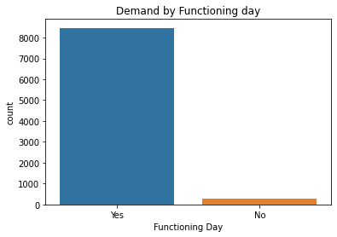
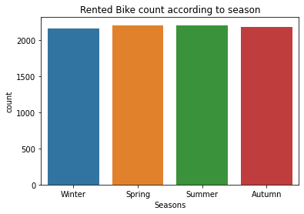
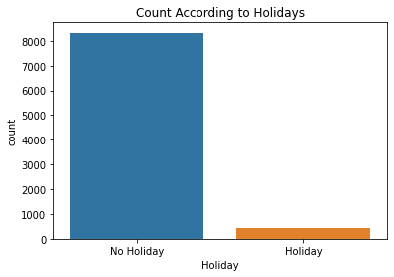
Basic Data Exploration

This Dataset has 8760 Row and 14 Columns.
There are 3 categorical features ‘Seasons’, ‘Holiday’, & ‘functioning Day’.
From datetime string we extract lots of features like day,year and month
Dataset contains no null values
No missing or duplicates values.

Slide 9

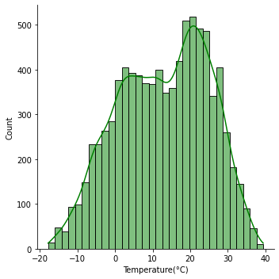
EDA - Tamprature condition
The temperature is mostly greater than zero and let’s consider as compared to cold the warm side is more So, it means the temperature has an effect.

Slide 10
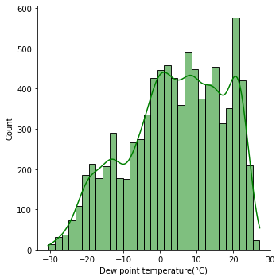
EDA - Dew Point Temperature
The dew point is the temperature the air needs to be cooled to (at constant pressure) to achieve a relative humidity

Slide 11
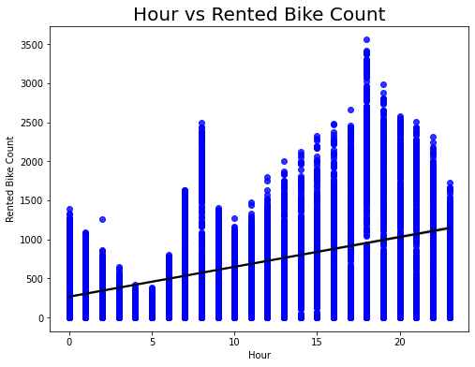
EDA - Rented bike count per hour
Hour is a numerical feature.
Hour: Demand for bike is mostly in morning (7 to 8) and in the evening (3 to 9).

Slide 12
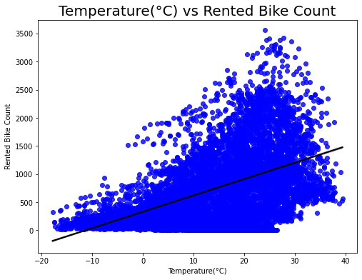
EDA - Relationship between bike count and Temperature
Temperature : Temperature is positively correlated. Rented bike count is highest between 20 °C and 30 °C. So, it means temperature has an effect.

Slide 13
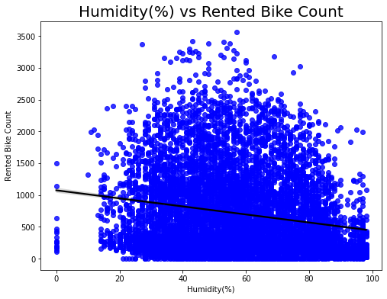
EDA - Relationship between bike count and Humidity
Humidity : Humidity is the amount of water vapor in the air. So, People preferring to borrow bike When there is less humidity.

Slide 14
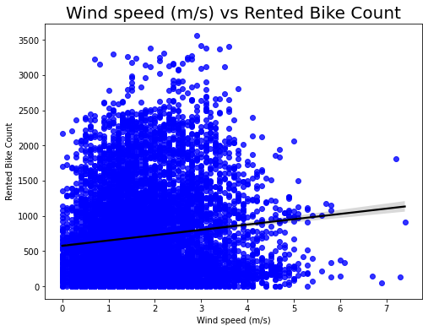
EDA - Relationship between bike count and Windspeed
Windspeed : Consumers prefer bikes when wind speed is in particular range but looking at plot, we can conclude that wind speed doesn't affect our data much.

Slide 15
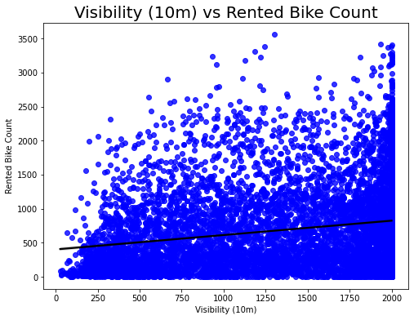
EDA - Relationship between bike count and Visibility
Visibility: Visibility doesn't affect our results much but all we know is that it is positively correlated with bike count.

Slide 16
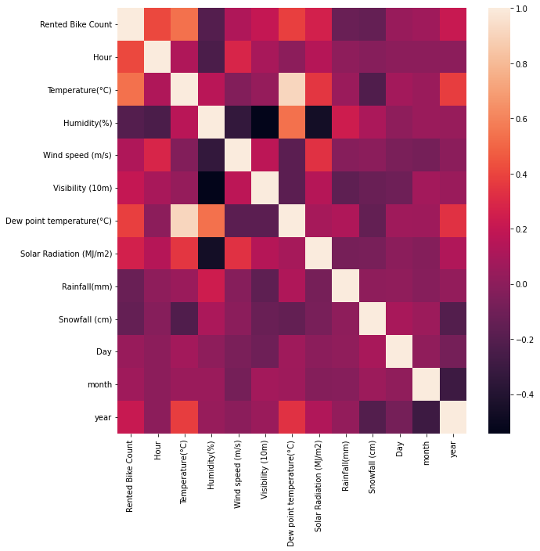
Correlation between Different factors by using Heatmap
Multicollinearity : Dew point temperature and Temperature are variables which are highly correlated.

Slide 17
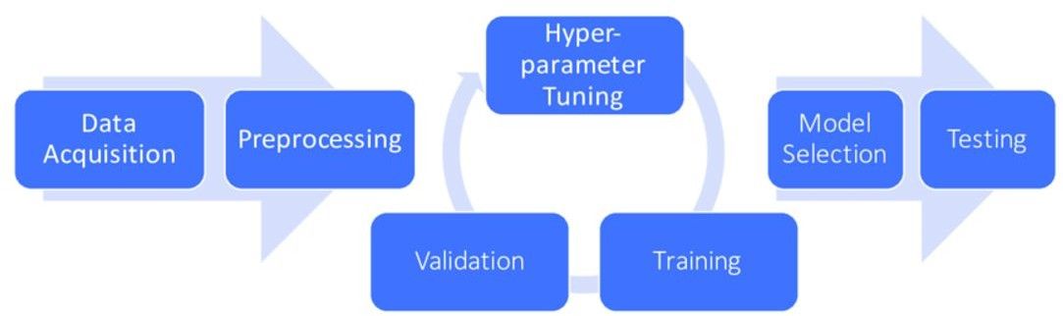
Preparing Dataset for Modelling
Dataset:
Train set: (7008, 19)
Test set: (1752, 19)
Handled ‘Dew point Temperature’ and ‘Temperature’ as they were highly correlated.
Carefully handled feature selection part as it affects R2 score.

Slide 18
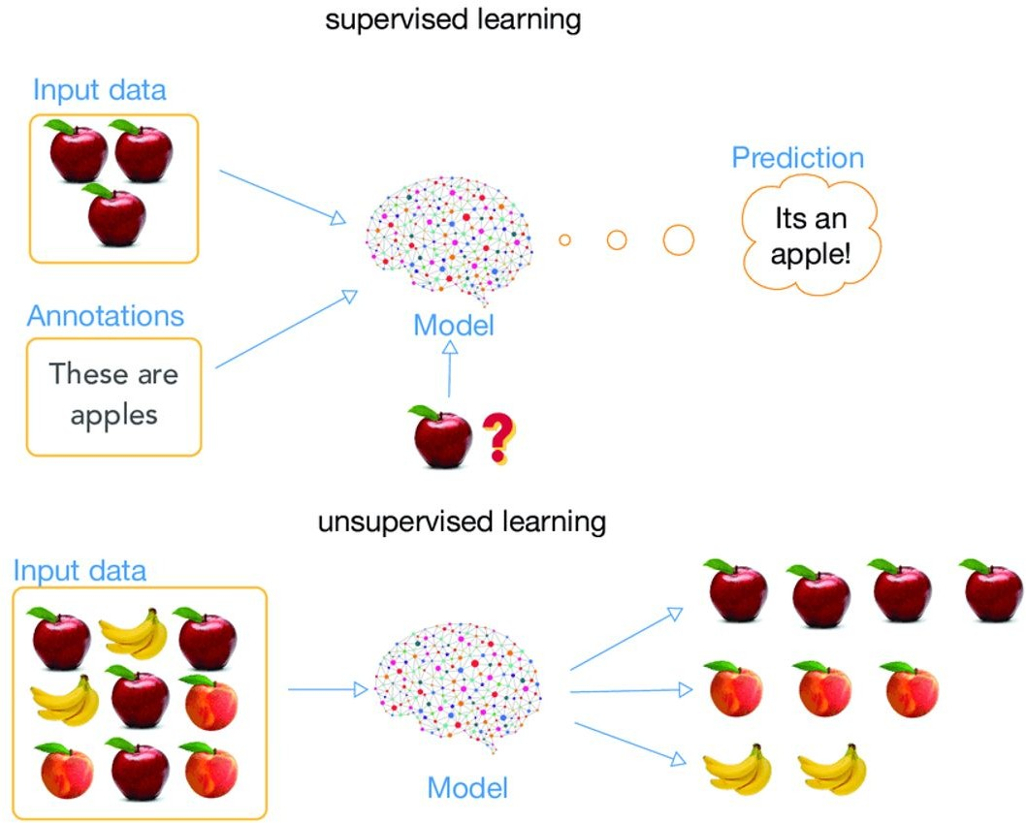
Modeling Overview
Type – Supervised Learning
In this project, we are using four models on our data set for getting the best performance :
LINEAR REGRESSION
LASSO REGRESSION
RIDGE REGRESSION
DECISION TREE

Slide 19
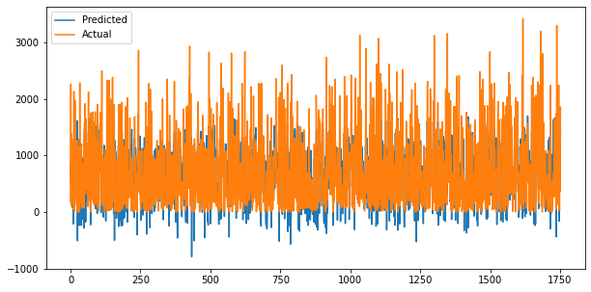
Implementing Linear regression (Baseline Model)
MSE : 195295.308108
RMSE : 441.92228740
R2 : 0.552945812579 Adjusted R2:0.54804
Accuracy is just 55%, we need to look for more algorithms.

Slide 20
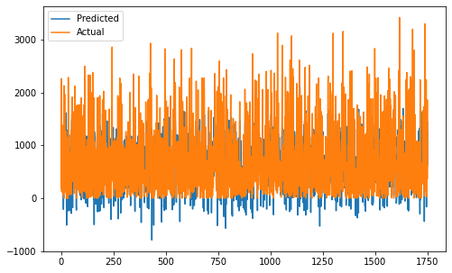
Implementing Lasso regression
MSE : 195304.3774
RMSE : 441.932548
R2 : 0.5505895051
Adjusted R2: 0.545
Accuracy is just 55%, we need to look for more algorithms.

Slide 21

Implementing Ridge regression
MSE : 195295.4841
RMSE : 441.9224865
R2 : 0.55294540960
Adjusted R2: 0.54804
Accuracy is just 55%, we need to look for more algorithms.

Slide 22
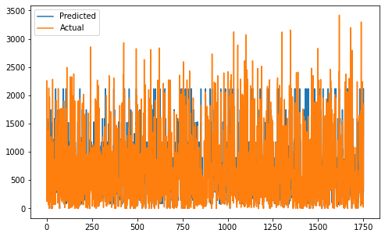
Implementing Decision tree.
MSE : 74173.8314044183
RMSE : 272.34873123335
R2 : 0.819415433962184
Adjusted R2 : 0.8174344254
decision tree gave decent results with approx. 81% accuracy.

Slide 23
Model Validation & Selection
Observation 1:From the model summary table, Linear regression is not giving us an accurate result.
Observation 2: lasso and ridge regressor didn’t give any good results either. So, we went for more M.L. models.
Observation 3: The decision tree gave decent results with approx. 81% accuracy.

Slide 24
Conclusion
There was a sharp increase in demand from the end of 2017 that too in the winter season of the year. The demand however decreases at the end of 2018.
Bike count rent is highly correlated with 'Hour', which seems obvious. Demand for bikes is mostly in the Morning (7 to 8) and in the evening(3to9).
After doing exploratory data analysis, applying Linear Regression model didn't go quite well as it gave only 55% accuracy.
Lasso and Ridge Regression help to reduce model complexity and prevent over-fitting which may result from simple linear regression. with Lasso and ridge, We got r squared values of 0.55 and 0.55, respectively.
With the Decision tree we reached the model r squared value of 0.81.

Slide 25

Challenges
Large dataset to handle
Feature engineering
Feature selection - Making sure we don’t miss any important feature.
Careful Handel affects R2 score.
Computation time

Slide 26


